Slide 1
Social Media Audit: Constance Sayers

Slide 2
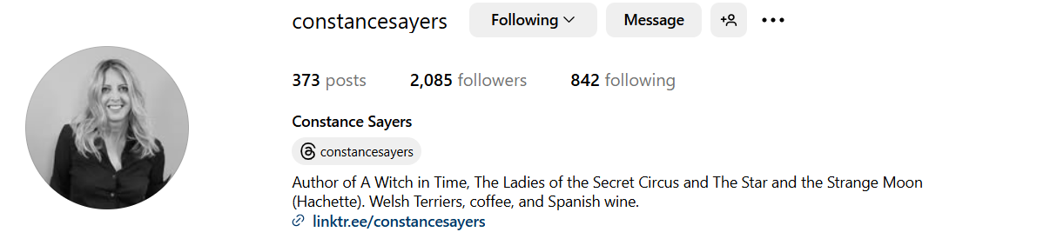
Followers: 2085.
Post interactions: between 10-50 per post.

Slide 3
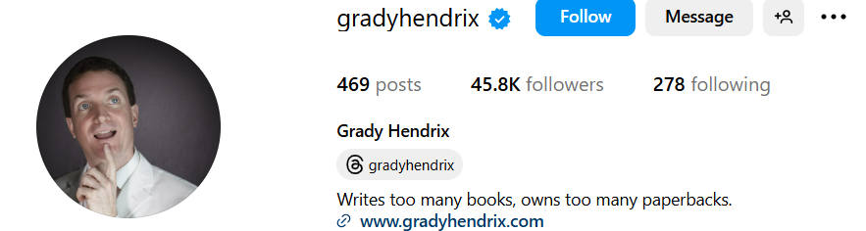
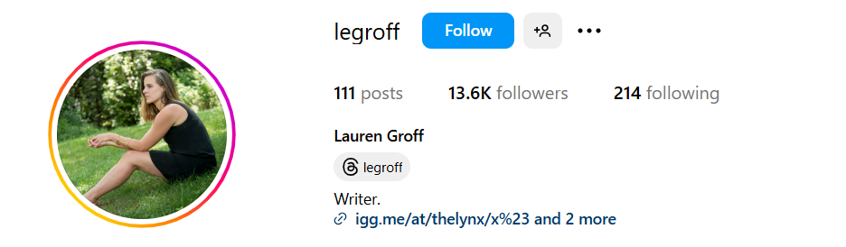
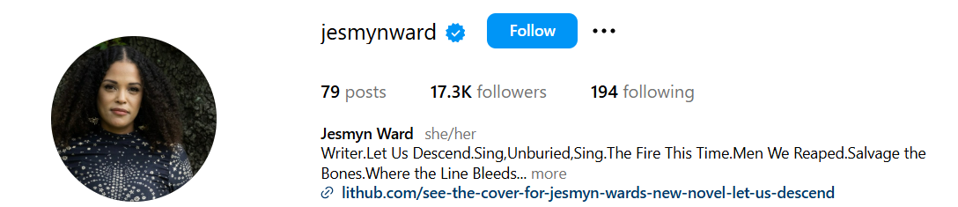
Competitor Analysis
By observing the social media accounts of similar Contemporary Southern Gothic authors, I have found that there is significant potential for growth in online presence.
Grady Hendrix: 45.8k followers.
Lauren Groff: 13.6k followers.
Jesmyn Ward: 17.3k followers.
All post regularly and regularly receive between 500-1500 interactions on posts.

Slide 4
SWOT Analysis
Strengths | Weaknesses
3 highly rated, best-selling novels to use for content. Strong community in Contemporary Southern Gothic genre. | Inconsistent posting. Posts about books don’t feature the cover or anything from the books.
Opportunities | Threats
Genre is popular with Bookstagram influencers. Large number of positive reviews on Amazon. | Inconsistent posting schedule could limit reach. Limited interactions mean less views for future promotions.

Slide 5
Social Media Plan
Goal.
Reach 10k followers on Instagram.
How to increase Instagram following.
Post regularly.
Include imagery/covers from the books in posts to increase interest in the books.
Use interactive posts such as polls and questions to increase number of interactions on posts and stories.
Interact with Bookstagram influencers to get reviews and more visibility for the books.
Interact and collaborate with other Contemporary Southern Gothic authors.
Content
Book cover posts.
Positive book review posts.
Repost Bookstagram influencer reviews.
Post video/podcst content about books/writing process.
Post about other authors in the Contemporary Southern Gothic genre to build a community.
Post polls about the books (favoutite character, favourite setting, etc.).
Post questions/AMAs in stories.
Fan art posts.
Pet photos.

Slide 6
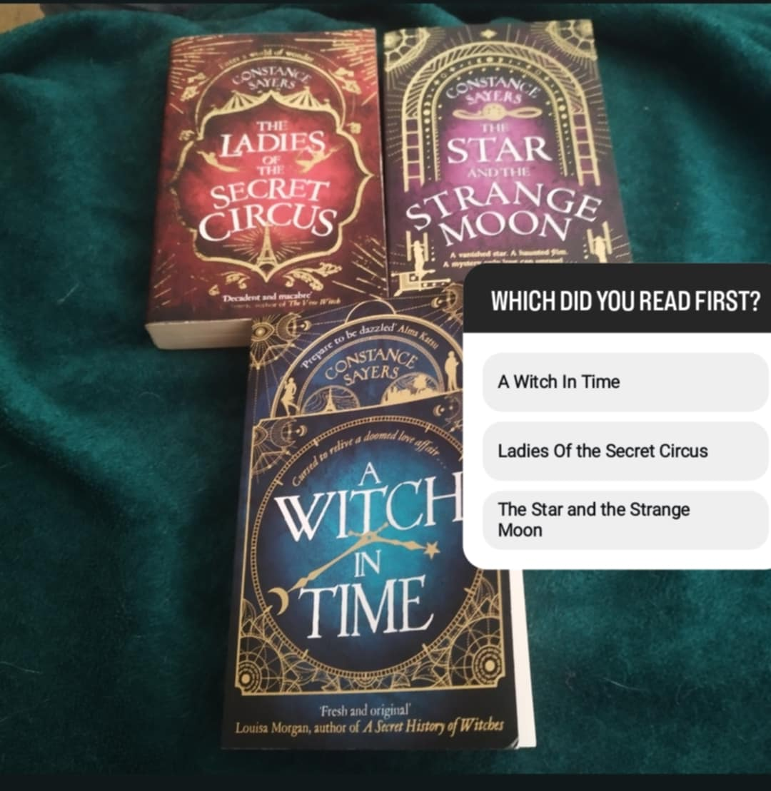
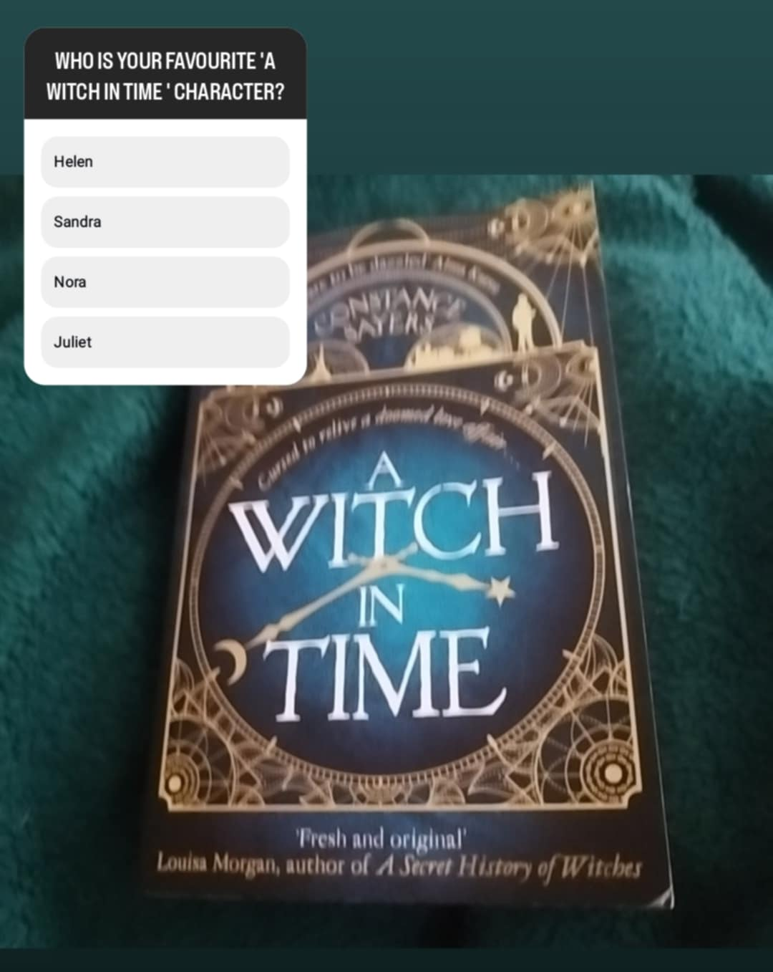
Post Examples: Polls and Questions.
Examples of potential polls and questions to increase engagement on Instagram.

Slide 7
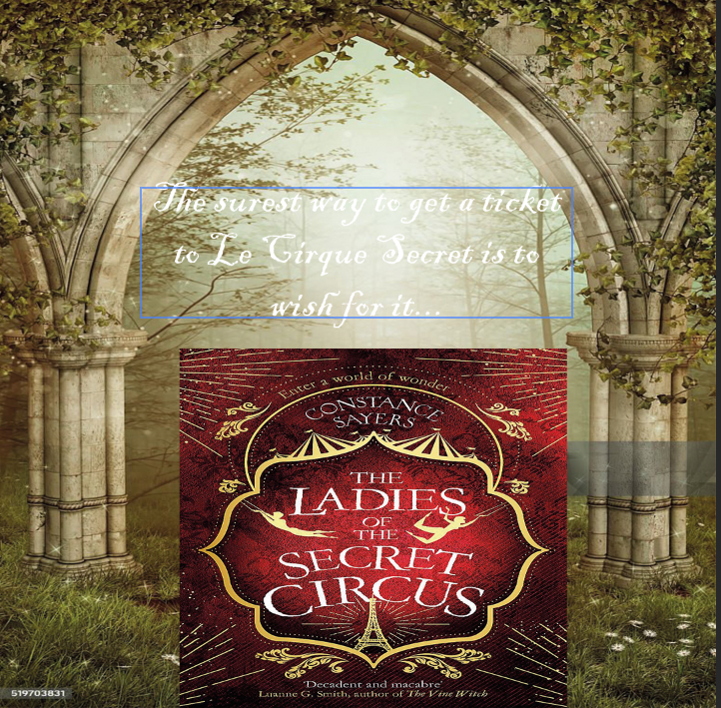
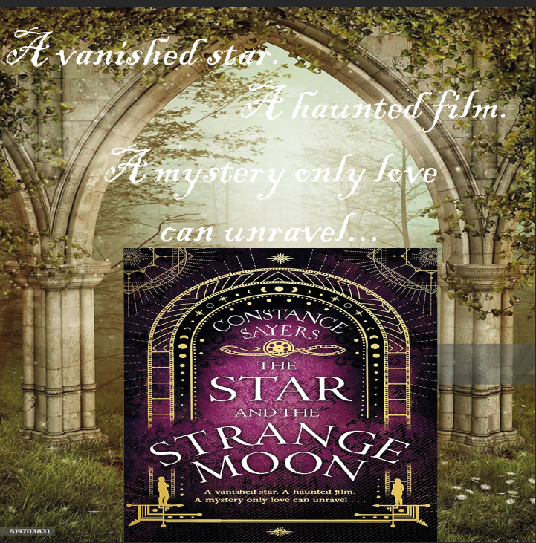
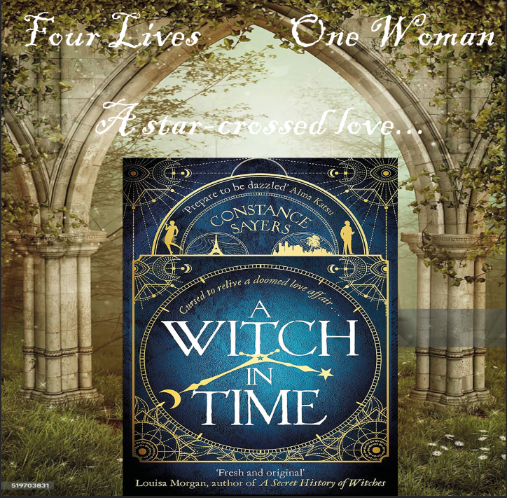
Post Examples: Book Covers.
An example of potential posts featuring the book covers, using an archway to link the Southern Gothic themes, and the taglines to increase interest in the story.

Slide 8
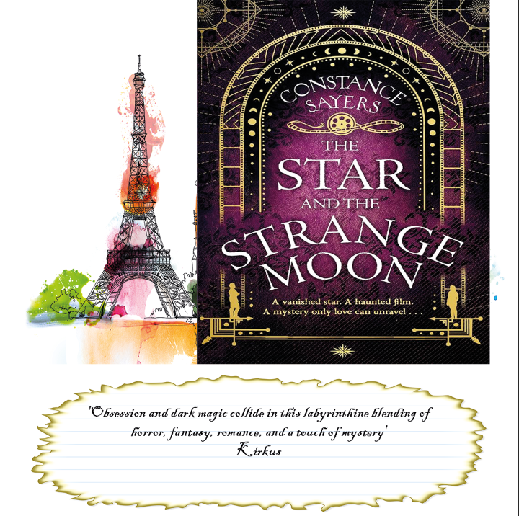
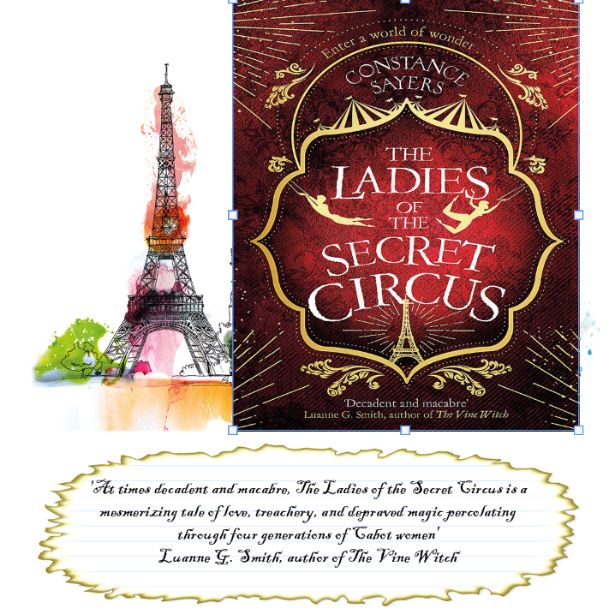
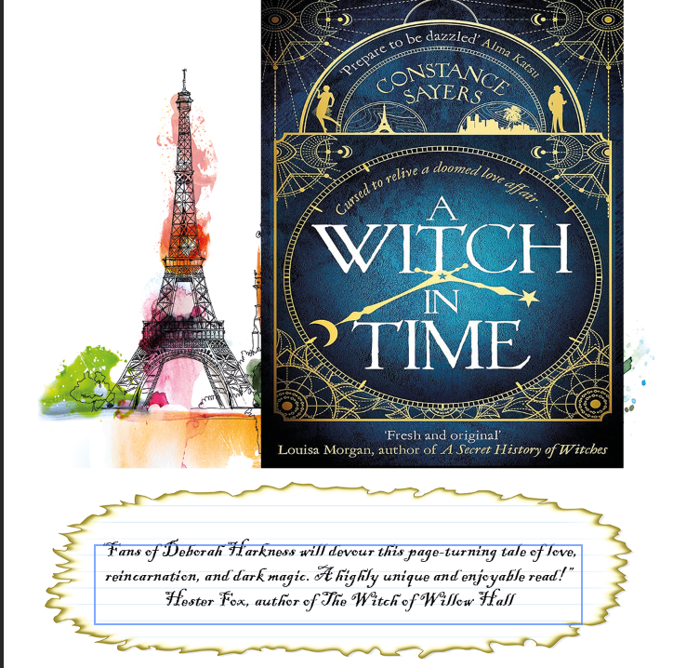
Post Ideas: Reviews.
Examples of potential posts including reviews of the books to build interest.

Slide 9
Conclusion
A Witch In Time, The Ladies of the Secret Circus, and The Star and the Strange moon are all incredible pieces of art that deserve a much larger presence online. Through regular and more interactive posts, as well as interaction and collaboration with influencers and authors, we can significantly increase engagement in the Instagram account. Not only would this be beneficial in increasing the numbers of followers towards our goal, but it will also be excellent for increasing awareness of the books already published and for building hype for any future books in the build up to the release date.

